Slide 1
Telecom Churn
A Data Refining
Operation
Notes:
The last presentation was a data gold mining adventure, this process will describe the refining proces apropos of the Zig ZIglar quote of refining “To get the gold, you;ve got to go through a lot of dirt!”

Slide 2
Technical environment used to create the dashboards
1
2
Jupyter Notebooks in lieu of pgadmin
Tableau

Slide 3
Functionality of the dashboard
1
Executive Dashboard

Slide 4
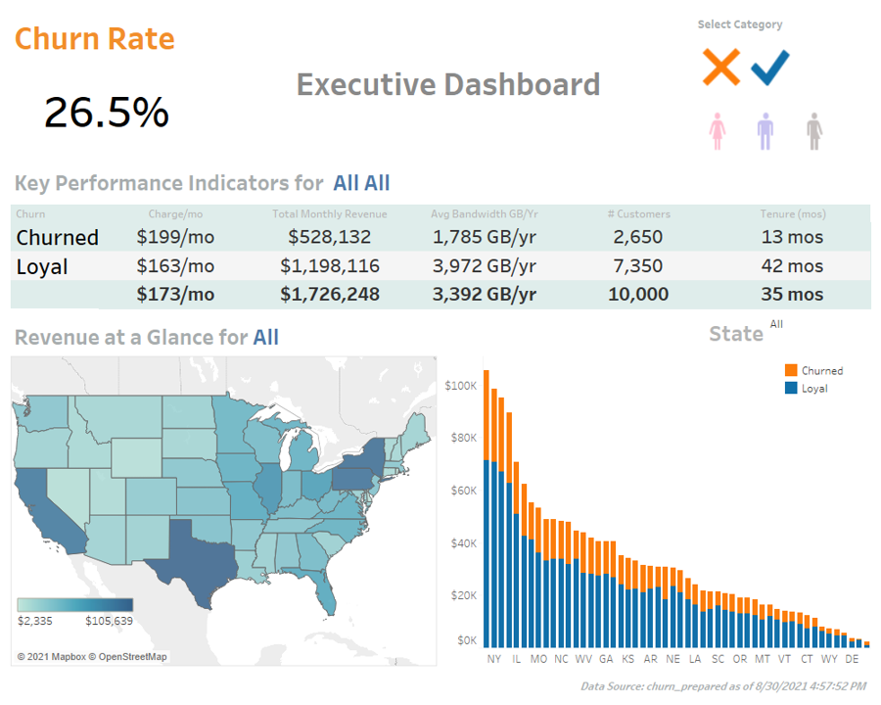
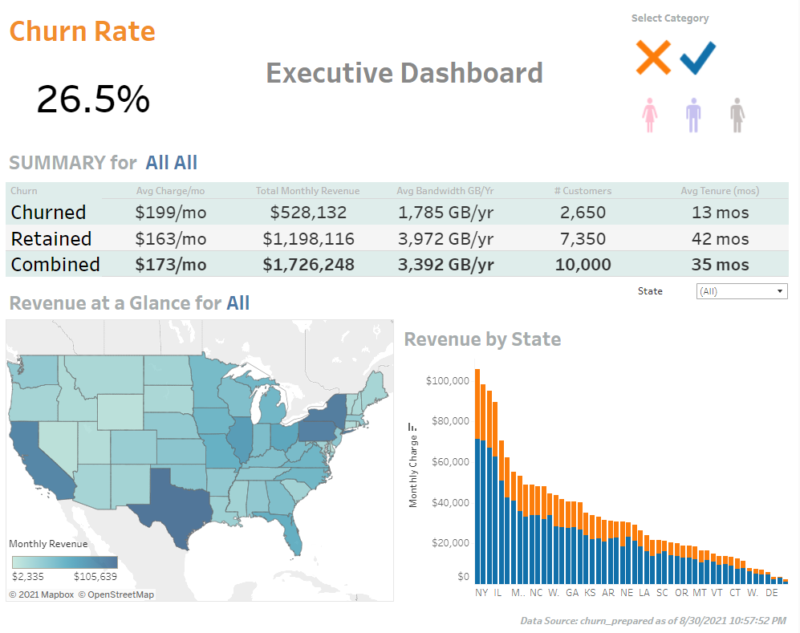
Click here

Slide 5
SQL scripts supporting the creation of the dashboards
1
2
Github repository
Jupyter notebook walkthrough

Slide 6
How the data streams were prepared to support analysis
1
Jupyter notebook walkthrough

Slide 7
How data were aligned with other data points
1
Jupyter notebook walkthrough

Slide 8
How the databases were created
1
2
Import with Pandas Dataframe function
Processed with Jupyter’s SQLite

Slide 9
How referential integrity was enforced in the database
1
2
Primary key: customer_id
Foreign keys: contract_id, job_id, location_id, payment_id, gender_id
Notes:
Referential integrity was enforced by “build[ing] and maintain[ing] logical relationships between tables to avoid logical corruption of data'' (w3resource, p. 1). Corresponding primary key and foreign key (customer_id, contract_id, job_id, location_id and payment_id) relationships were set up to avoid any corruption of the data in SQL joins

Slide 10
Sources
Executive Dashboard
Python source code repository
Kaggle & IBM Telco Customer Churns dataset

